Slide 1
Career Development Training Course
Reenlistments and Contract Extensions

Slide 2
Enabling Objectives
DEFINE reenlistment and extensions.
IDENTIFY the eligibility factors for reenlistments.
IDENTIFY the eligibility factors for extensions of enlistments.
IDENTIFY when the OBLISERV to Train (OTT) option is available.
IDENTIFY when Page 13 in lieu of OBLISERV is available.
IDENTIFY the difference between EAOS and SEAOS.
IDENTIFY the reasons for extension cancellations.
DETERMINE when leave sell-back is authorized.
Notes:
FACILITATORS GUIDE:
Review objectives.

Slide 3
References
MILPERSMAN 1160-020, Reenlistment Ceremony
MILPERSMAN 1160-030, Enlistments and Reenlistments Under Continuous Service Conditions
MILPERSMAN 1160-040, Extension of Enlistments
MILPERSMAN 1160-060, Agreement of Enlisted Naval Reservist to remain on Active Duty
MILPERSMAN 1160-120, High Year Tenure
MILPERSMAN 7220-340, Lump-Sum Payment for Accrued Leave
Notes:
FACILITATOR GUIDE:
Review references.

Slide 4
Reenlistment and Extensions
Defined
What is a Reenlistment?
  MILPERSMAN 1160-030
  When a member has previously served an enlistment in the active or reserve component, the next enlistment therein will be termed a “reenlistment.”
  Official form:
    NAVPERS 1070/601, Immediate Reenlistment Agreement
    NAVPERS 1070/622, Agreement to Recall or Extend Active Duty (in addition to Reenlistment Agreement this is required for TAR personnel and SELRES recalled to Active Duty)
What is an Extension?
  MILPERSMAN 1160-040
  An agreement between the U.S. Government and the enlisted member to extend the current enlistment in the Navy or Naval Reserve.
  Official form:
    NAVPERS 1070/621, Agreement to Extend Enlistment
Notes:
FACILITATOR GUIDE:
None

Slide 5
Reenlistment Eligibility
OBLISERV authorization
U.S. Citizen; Noncitizen nationals; or Immigrant alien members who have been lawfully admitted into the U.S.
Medically qualified
Meet HYT requirements
Security Clearance (if required by rating)
Meet Professional Growth Criteria:
  Serving as a Petty Officer; or
  E-3 and approved for SRB; or
  E-3 and approved to convert from TAR to AC
  Receive a minimum recommendation of "Promotable" and recommended for retention on last graded evaluation (none observed evaluations are not considered graded)
Physical fitness requirements:
  Refer to OPNAVINST 6110.1 (series), Physical Readiness Program and current NAVADMINS to determine physical fitness eligibility
Notes:
FACILITATOR GUIDE:
1. Discuss reenlistment eligibility and any applicable updates
NOTE: Security Clearance status is not specifically stated as a requirement in MPM 1160-030. However, if a Sailor is not eligible for a clearance or does not have the required level clearance for their rate on their CWAY Sailor Details section or manually created CWAY application, a reenlistment will not be authorized.
2. Enlisted members with two or more consecutive PFA failures will result in adverse actions that can affect reenlistment.
NOTE: OPNAVINST 6110.1J, removed mandatory ADSEP processing for PFA failures

Slide 6
High Year Tenure
(HYT)
References:
AC/TAR: MILPERSMAN 1160-120
SELRES/IRR/USNR-S1: MILPERSMAN 1160-135
Purpose:
  The high year tenure (HYT) policy is a vital and effective force management tool utilized to properly size and shape the Active Component (AC) and Reserve Component (RC).
  HYT management is regulated by establishing standardized length-of-service (LOS) gates by pay grade balanced with a waiver process to enable the Navy to retain the right number of members.
**Reference HYT specific NAVADMINS for recent changes**
Notes:
FACILITATOR GUIDE:
Inform CDT to always verify current MPM and NAVADMINs that address HYT policy to determine a member’s eligibility.
Note: SELRES/IRR/USNR-S1 have a higher Length of Service (LOS) Gate than AC/TAR. Example: E-5 SELRES HYT is 20 years.

Slide 7
HYT Limits
Active and TAR Sailors
E-1 TO E-2 | 4 Years
E-3 | 6 Years
E-4 | 10 Years
E-5 | 16 Years
E-6 | 22 Years
E-7 | 24 Years
E-8 | 26 Years
E-9 | 30 Years
SELRES, IRR and USNR-S1
E-1 TO E-2 | 6 Years
E-3 | 10 Years
E-4 | 14 Years
E-5 | 20 Years
E-6 | 22 Years
E-7 | 24 Years
E-8 | 26 Years
E-9 | 30 Years
**Reference HYT specific NAVADMINS for recent changes**
https://www.mynavyhr.navy.mil/Career-Management/Community-Management/Enlisted-Career-Admin/High-Year-Tenure/
Notes:
FACILITATOR GUIDE:
Review HYT limits…discuss any recent changes if applicable.

Slide 8
Requirements for Reenlistment
Reenlistment ceremonies:
  MILPERSMAN 1160-020
Required counseling:
  MILPERSMAN 1160-031
MNA Authorization is required for all rated E-3 through E-6 with less than 14 years of service.
Terms of reenlistment are: 2, 3, 4, 5, or 6 years
  New contract must equal or exceeds period of service member is already obligated.
  SRB reenlistments require minimum term of 3 years and it must go to the next zone.
Notes:
FACILITATOR GUIDE:
Speak on unique/significant reenlistment ceremonies you have facilitated or witnessed that stood out (fun location, deployments, etc.).
Early reenlistments:
No requirement to forward to PERS-811 for approval
Applies to all Sailors regardless whether or not the member is subject to CWAY approval
Conditional reenlistments:
Required PERS-811 approval (AC), PERS-812 approval for (RC)
Example of when this type may be required: Sailor has 48 months of operative extension, are eligible for reenlistment and require a OBLISERV (i.e. Fleet Reserve to meet approved fleet reserve date)
See MPM 1160-030 for additional reasons for conditional reenlistments

Slide 9

Reenlistment Ceremony
MILPERSMAN 1160-020
“During a reenlistment ceremony, the reenlisting Sailor makes a personal commitment in a public forum to wear the cloth of the nation with honor, courage and commitment.”
          Who CAN ADMINISTER THE OATH?: Per 10 U.S.C. 502(a), The President, Vice President, Secretary of Defense, and any commissioned officer and any other person designated under regulations prescribed by the Secretary of Defense.
          Where: Venue shall reflect pride, professionalism and dignity for the oath and Navy.
          Attire: In Uniform
          NOTE: Senior enlisted CANNOT officially administer the Oath of Enlistment.
Notes:
FACILITATOR GUIDE:
Ensure to emphasize that Senior Enlisted cannot administer the Oath of Enlistment. This also includes civilian family members (spouse, kids, etc.).
Who: Per reference (a) (10 U.S.C. 502(a) ), the President, the Vice-President, the Secretary of Defense, any commissioned officer, and any other person designated under regulations prescribed by the Secretary of Defense may administer the reenlistment oath. Senior enlisted CANNOT officially administer the Oath of Enlistment
Where: Each reenlistment shall be performed in uniform and should be memorable with the right tone and venue to reflect pride, professionalism, respect, and dignity for the oath and the United States Navy. Examples include members command (standing on the anchor, under the ship while in dry dock, etc.), sporting events (on the field during a game), landmarks (USS MIDWAY, beach), or a location significant to the member.
Attire: Both the Sailor reenlisting and the reenlisting officer are required to be in uniform.

Slide 10
Extension of Enlistments
MILPERSMAN 1160-040
Conditional:
  Extensions are executed as prescribed and are for periods of 1-48 months.
Dates:
  Execution date = the date signed
  Operative date = date the extension goes into effect (EAOS + 1 day)
Notes:
FACILITATOR GUIDE:
None.

Slide 11
Reasons to Extend Enlistment
COs and OICs can authorize extensions without PERS approval, if they are for one of the following reasons:
  Match EAOS with PRD
  Obtain Maternity Care Benefits (self or spouse)
  Obtain OBLISERV for Orders
  Obtain OBLISERV as required by Navy directives, NAVADMIN, or MILPERSMAN (ex. to Fleet Reserve/Retirement date or HYT)
Exception: Nuclear Trained Sailors seeking extensions beyond 23 months require approval from OPNAV N133.
Notes:
FACILITATOR GUIDE:
None.

Slide 12
Cancellation of Extensions
Extensions may be cancelled if:
  Sailor extends for benefit, but it is not received through NO fault of their own.
  Disenrolled from specialized course through NO fault of their own.
  Reenlists beyond the current SEAOS date.
  Is no longer recommended for retention:
    Evaluation
    Loss of required security clearance
  Is found to be not physically qualified.
Note: Extensions that have become OPERATIVE may not be cancelled.
Notes:
FACILITATOR GUIDE:
Examples of extension with benefits are:
School
Accelerated advancement
Did not execute PCS orders
Enlistment bonus

Slide 13
Lump Sum Leave (LSL)
MILPERSMAN 7220-340
  Members cannot sell more than 60 days in a military career.
Monetary entitlement payable:
  Reenlistment.
  Separation from Active Duty.
  The effective date of a first extension of enlistment.
  Death.
LSL Calculation:
  Base Pay/30= Daily Norm or Daily Base Rate (DBR)
  DBR x number of days = LSL
Notes:
FACILITATOR GUIDE:
None.

Slide 14
Forms
NPPSC 1160/1 Command Career Request
NPPSC 1160/2 CPPA Reenlistment Checklist
  Used for both reenlistments and extensions
  MyNavy HR > References > Forms > NPPSC Forms
Notes:
FACILITATOR GUIDE:
None.

Slide 15
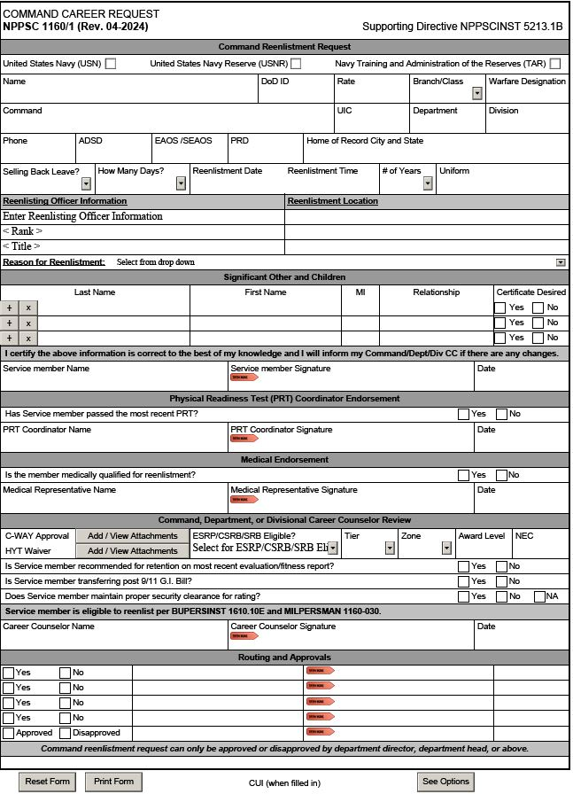
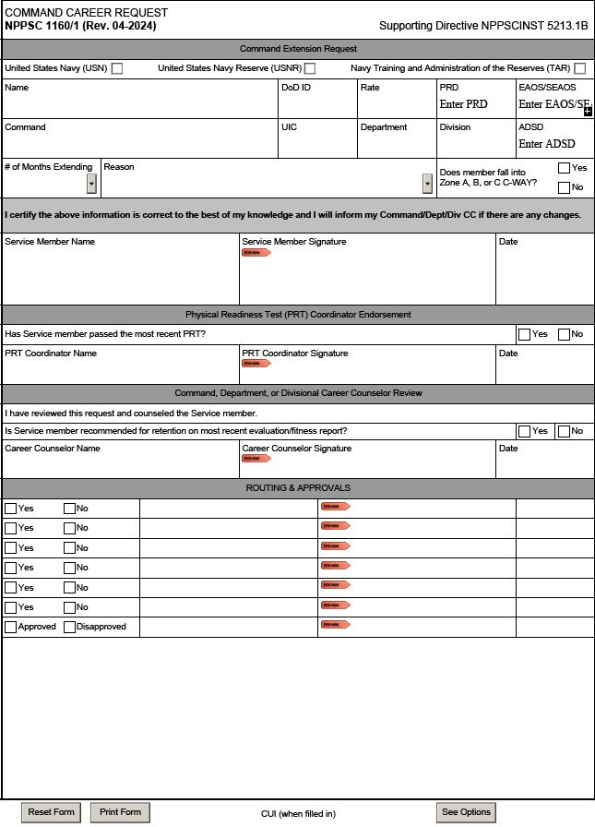
Command Career Request
NPPSC 1160/1
SAMPLE
SAMPLE
Reenlistment Request
Extension Request
Notes:
FACILITATOR GUIDE:
See screenshot.

Slide 16
Best Practices
Discuss GI Bill transferability requirements
  Minimum of 6 years of service required with a 4-year obligation.
  Sailors have 30 days from date of reenlistment to transfer benefits with a 4-year reenlistment.
Ensure SRBs are submitted as early as possible (120-35 days prior to reenlistment day).
Download loss reports monthly via NSIPs to ensure accurate tracking of personnel.
Maintain 15-month roller with member's career decisions.
Follow up! Ensure EAOS/SEAOS are updated, SRB approval messages are received to prevent delays in creating contracts.
Discuss record review requirements with Sailors to ensure ESR close-out is accurately reflecting in OMPF upon reenlistment.
Discuss updating or verifying dependency data and SGLI prior to reenlistment and upon transferring.
Notes:
FACILITATOR GUIDE:
Add any best practices/experiences you have here.
Show example of 15 month roller.
Is there a specific template you want your Dept/Div CC’s to use? If so, train to it so they are aware of your expectations.

Slide 17
Knowledge Check
Use the Sailor details below to answer the questions.
Can NC1 Joe Navy reenlist on the requested date? Explain your answer and the reference
What is the maximum amount of time NC1 could reenlist for and why?
Is he affected by the current HYT policy and require a HYT waiver?
  NC1 Joe Navy
    ADSD: 6/15/2005
    EAOS: 2/28/2024
    SEAOS: 3/1/2025
    Requested reenlistment date: 6/15/2023
    Not eligible for SRB
Notes:
ANSWERS:
YES, Member could reenlist as early as they want as long as their new EAOS exceeds past their current SEAOS. Reference MPM 1160-030.
Maximum of 3 years, new EAOS would be 6/14/26. Must reenlist day for day for what is currently reflecting on enlistment contract.
Must cover remaining 21 months on contract
No the HYT for first class is 22 years.

Slide 18
Summary and Review
In this lesson we discussed:
  Defined reenlistment and extensions
  The eligibility factors for reenlistments and extensions of enlistments
  HYT
  Reenlistment incentives
  Reenlistment ceremonies
  OBLISERV to Train (OTT)
  Extension cancellations
  Leave sell-back

Slide 19
Reenlistments and Extensions
Questions?

